Slide 1

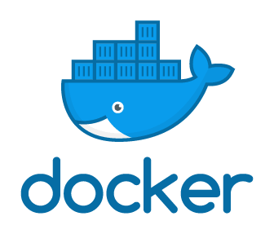
Introducing Docker
Simon Stride July 2019

Slide 2
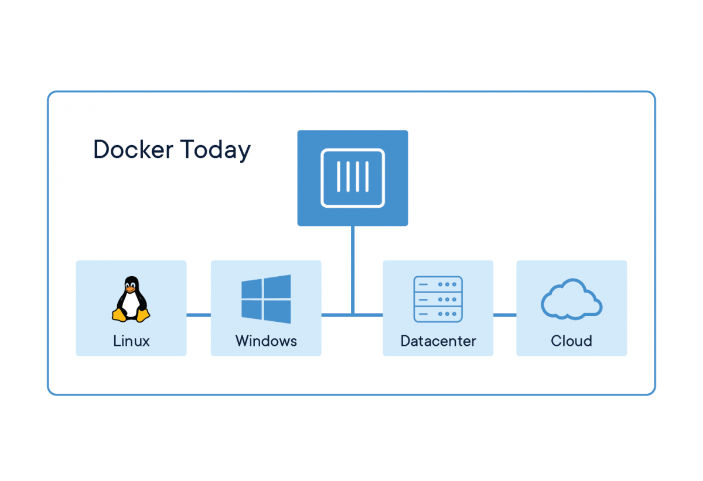
What is Docker?
Docker is an open source, Developer-centric containerisation technology created in 2013
The Docker Engine creates isolated cgroups and namespaces,
Originally on Linux hosts but now includes Windows
Notes:
Cgroups = Control Groups (collection of processes)
Docker didn’t invent containers – but they did create great tooling around the computing concepts of isolated namespaces
https://www.docker.com/why-docker

Slide 3

Why do developers like Docker?
Consistency
Repeatability
Isolation
Dev Tooling (Docker Desktop)
Production Tooling (Swarm, Kubernetes)
Quick to install new software
No unwanted installers, traces, registry keys after uninstall
Notes:
Plus a really strong set of docs and community support
Docker has become the defacto standard for containerisation!

Slide 4

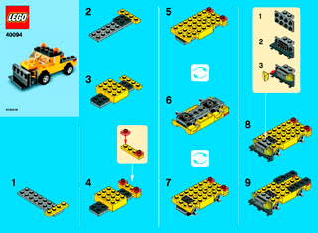
All Developers using the same image get the same output.

Slide 5
Why do DevOps folks love Docker?
Docker images provide a standardised, consistent means of deploying containers between environments, small and large
This includes load-balanced, big scale services like Google, Paypal, VISA and Netflix. Plus Splunk!
Run the exact same workload irrespective of underlying platform – AWS, Azure, GCP or on-prem
Speed and repeatability of installing and running images
No need to patch – update the image (OS or App) drop the container and recreate
Notes:
https://www.theregister.co.uk/2014/05/23/google_containerization_two_billion/
https://medium.com/netflix-techblog/the-evolution-of-container-usage-at-netflix-3abfc096781b
Also, kernel virtualisation means guest OS’s aren’t replicated on a host – allowing for greater guest density on the same hypervisor => reduced infrastructure costs on prem
“Cattle not pets”

Slide 6
What are Containers?
Containers are a self-contained unit of software, including the OS namespaces
The guest OS doesn’t have any “awareness” of the host or other containers (unless you specially tell it) => security
It might help to think of contains a bit like a VM – but with an explicit instruction manual defined by the developer
Notes:
“A container is a standard unit of software that packages up code and all its dependencies so the application runs quickly and reliably from one computing environment to another. A Docker container image is a lightweight, standalone, executable package of software that includes everything needed to run an application: code, runtime, system tools, system libraries and settings.”
Source: https://www.docker.com/resources/what-container
“Secure: Applications are safer in containers and Docker provides the strongest default isolation capabilities in the industry”
Source: https://www.docker.com/resources/what-container
Compared to VMS running on the same tin, running a VM per app would mean 6 copies of guest OS files, and guest OS resources when running. Containers therefore need less resources

Slide 7
Demo – Run MongoDb
docker run -d -p 27017:27017 mongo

Slide 8
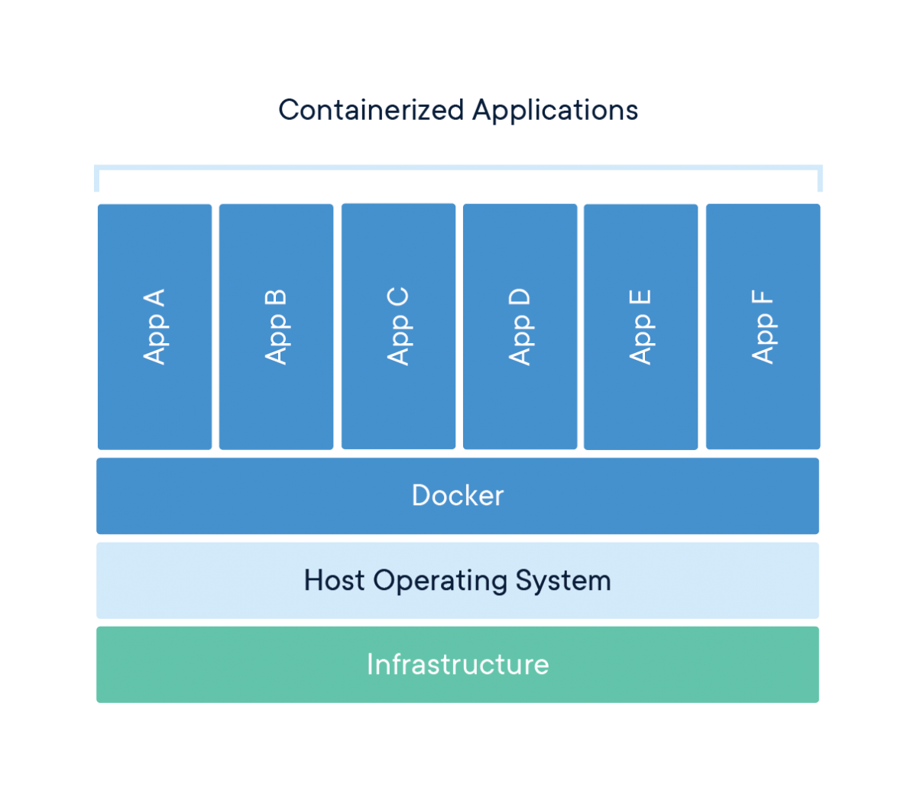
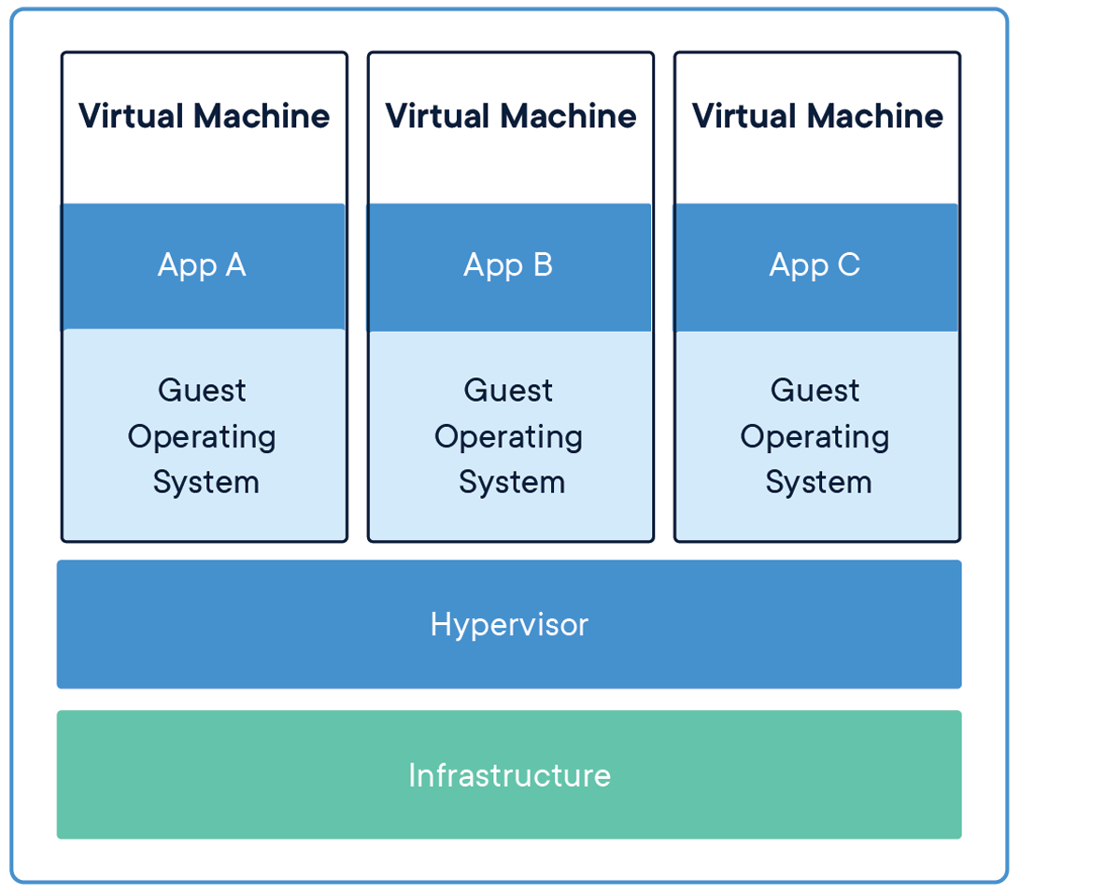
Containers vs Virtual Machines
Notes:
The guest app has access to an isolated portion of the host Kernel but unlike VMs doesn’t need a copy of the entire OS
CONTAINERS
Containers are an abstraction at the app layer that packages code and dependencies together. Multiple containers can run on the same machine and share the OS kernel with other containers, each running as isolated processes in user space. Containers take up less space than VMs (container images are typically tens of MBs in size), can handle more applications and require fewer VMs and Operating systems.
VIRTUAL MACHINES
Virtual machines (VMs) are an abstraction of physical hardware turning one server into many servers. The hypervisor allows multiple VMs to run on a single machine. Each VM includes a full copy of an operating system, the application, necessary binaries and libraries - taking up tens of GBs. VMs can also be slow to boot.

Slide 9
Docker Installation For Developers
Linux
https://docs.docker.com/install/linux/docker-ce/ubuntu/
https://docs.docker.com/install/linux/docker-ce/centos/
Windows 10 and Mac OSX
https://www.docker.com/products/docker-desktop
https://docs.docker.com/docker-for-mac/install/
Windows 7
Docker toolbox – uses Virtual Box to emulate Linux host

Slide 10
Images
In Docker, an Image is the blueprint, or instruction set for building a running container
When run, the image is used to create a running instance of the image, aka a Container
If the same set of instructions is run on a different host, you get the same output
Images can take another image as a starting point, meaning you don’t have to start from scratch
Notes:
For example imagine steps 1-7 of these instructions create the base for a Lego jeep, car and truck

Slide 11
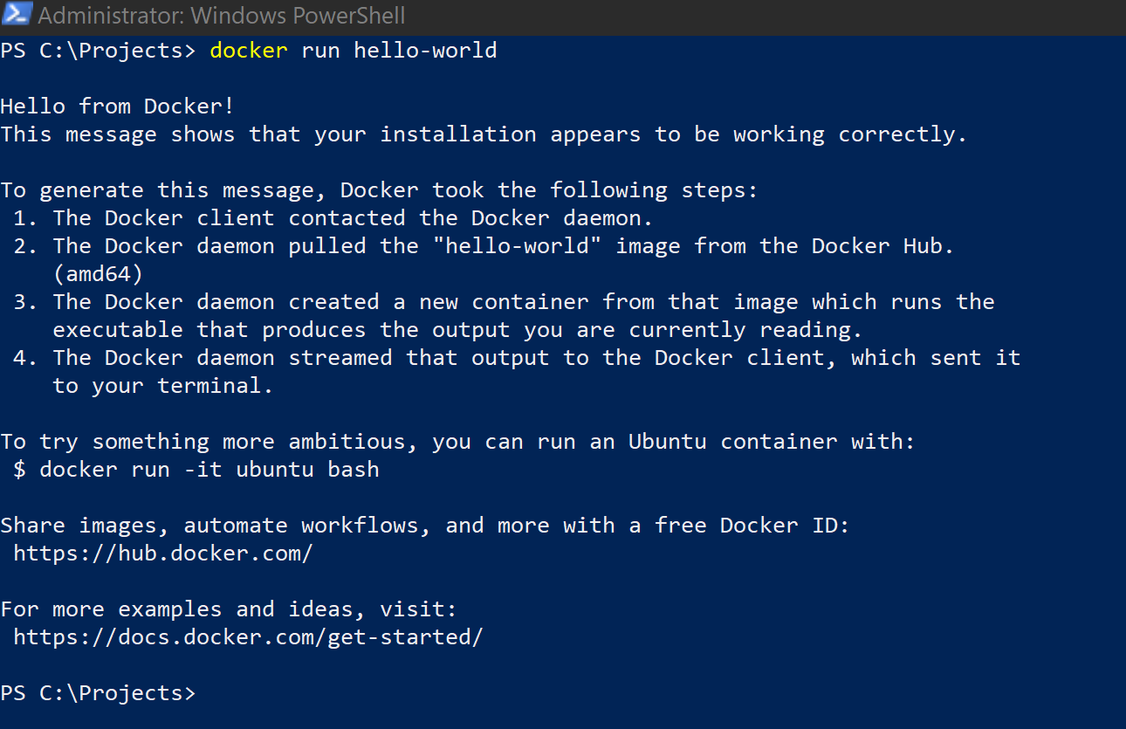
Docker Demo

Slide 12
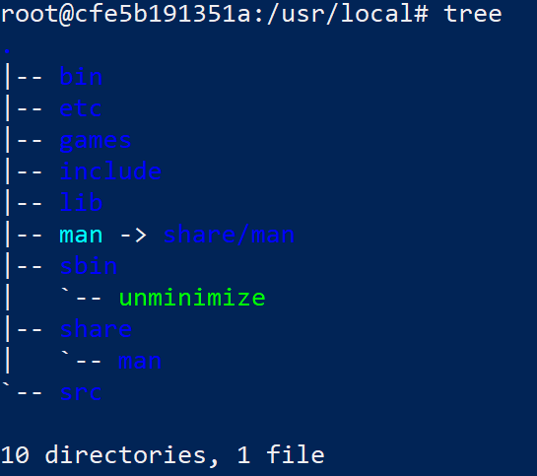
Demo – running ubuntu linux on Windows
Notes:
In posh
docker run –it ubuntu /bin/bash
apt update
apt install tree
cd /usr/local
tree

Slide 13
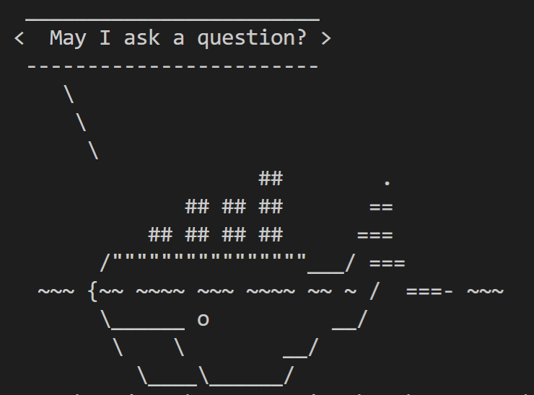
Dockerfile
Dockerfiles allow us to persist configuration settings, copy in code, run commands and prep our custom images
Dockerfiles must be “built” using the “docker build” command, which will execute the instructions in the dockerfile
Dockerfiles build on existing base images – can be an OS image e.g. Ubuntu or can be an OS plus other software e.g. Node
Notes:
Dockerfiles are a DSL for setting up docker images
These instruction sets provide consistency between environments

Slide 14
Demo – simple dockerfile
Create a ubuntu image that already has tree installed when we run it
Notes:
Tree is available from the aptoide repository, so we can use apt-get install tree (once we’ve run an aptoide update)

Slide 15
Demo - More dockerfiles
Bringing up SQL Server with Adventureworks

Slide 16
Docker Compose
Docker compose combines your dockerfiles with the switches from command line plus the ability to run multiple services
…best illustrated with a demo!

Slide 17

Container Registries
Container Registries provide a means of storing your docker images
Can be public or private
Docker Hub is the most commonly used public Container Registry
https://hub.docker.com
Create your own private registry using Azure, AWS, GCP

Slide 18
And there’s more!
Containers are disposable! Volumes give us the ability to persist data when tearing down/running updated containers
Networks define how services talk to one another
Layers allow portions of Docker images to be reused – only the surface code changes. This means less to download!

Slide 19
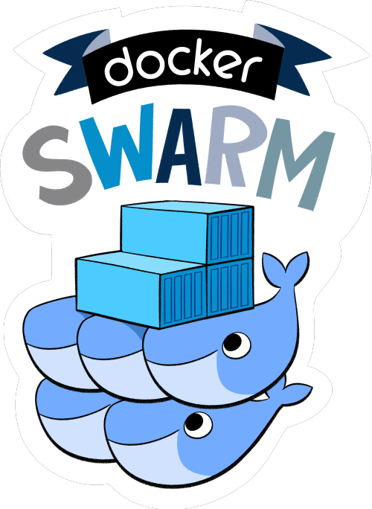
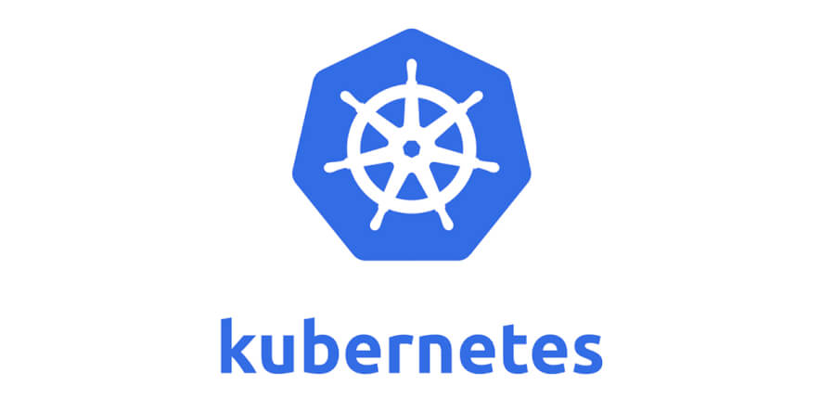
Production Orchestration
Docker Desktop is great for developing… But what about production workloads?
Notes:
Azure Container Instances allow you to run a single container. Or install docker on a server (Linux or Windows 2016+)
For “real” horizontal scaling Kubernetes and Swarm are container orchestration engines with their own tooling and training sessions!
Kubernetes from Google and Swarm from Docker both can be configured to:
Connect to a container registry and update themselves
Self repair if a container is deemed “unhealthy”
Have autoscale features and add additional containers based on usage (e.g. high CPU, RAM)
Scale groups of containers (Pods) without scaling the whole application
Can implement loading balancing across containers in a cluster
Allow for blue/green releases or canary deployments

Slide 20
Further Resources
https://docs.docker.com/docker-for-windows/
https://docs.docker.com/engine/reference/
https://docs.docker.com/engine/reference/run/
https://docs.docker.com/compose/
https://hub.docker.com/
https://kubernetes.io/

